Slide 1
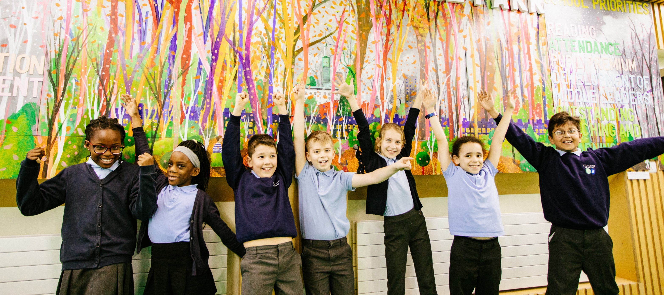


Why should we choose Artsmark?
Photo © The LPA / Hillyfield Primary Academy

Slide 2

What is Artsmark?
Artsmark empowers teachers with the skills they need to embed arts, culture and creativity across the whole curriculum.
Schools are recognised for their exceptional commitment to creativity with the Artsmark Award, accredited by Arts Council England – the only award for arts and cultural provision in England.
Notes:
The link to this animation is here: https://youtu.be/_nhf1txYF6c?list=PLzzBvi5D8s7OF65sRy6Xqf_QPgGs5VxIw
You can find out more about the Artsmark process here: How Artsmark works | Artsmark

Slide 3
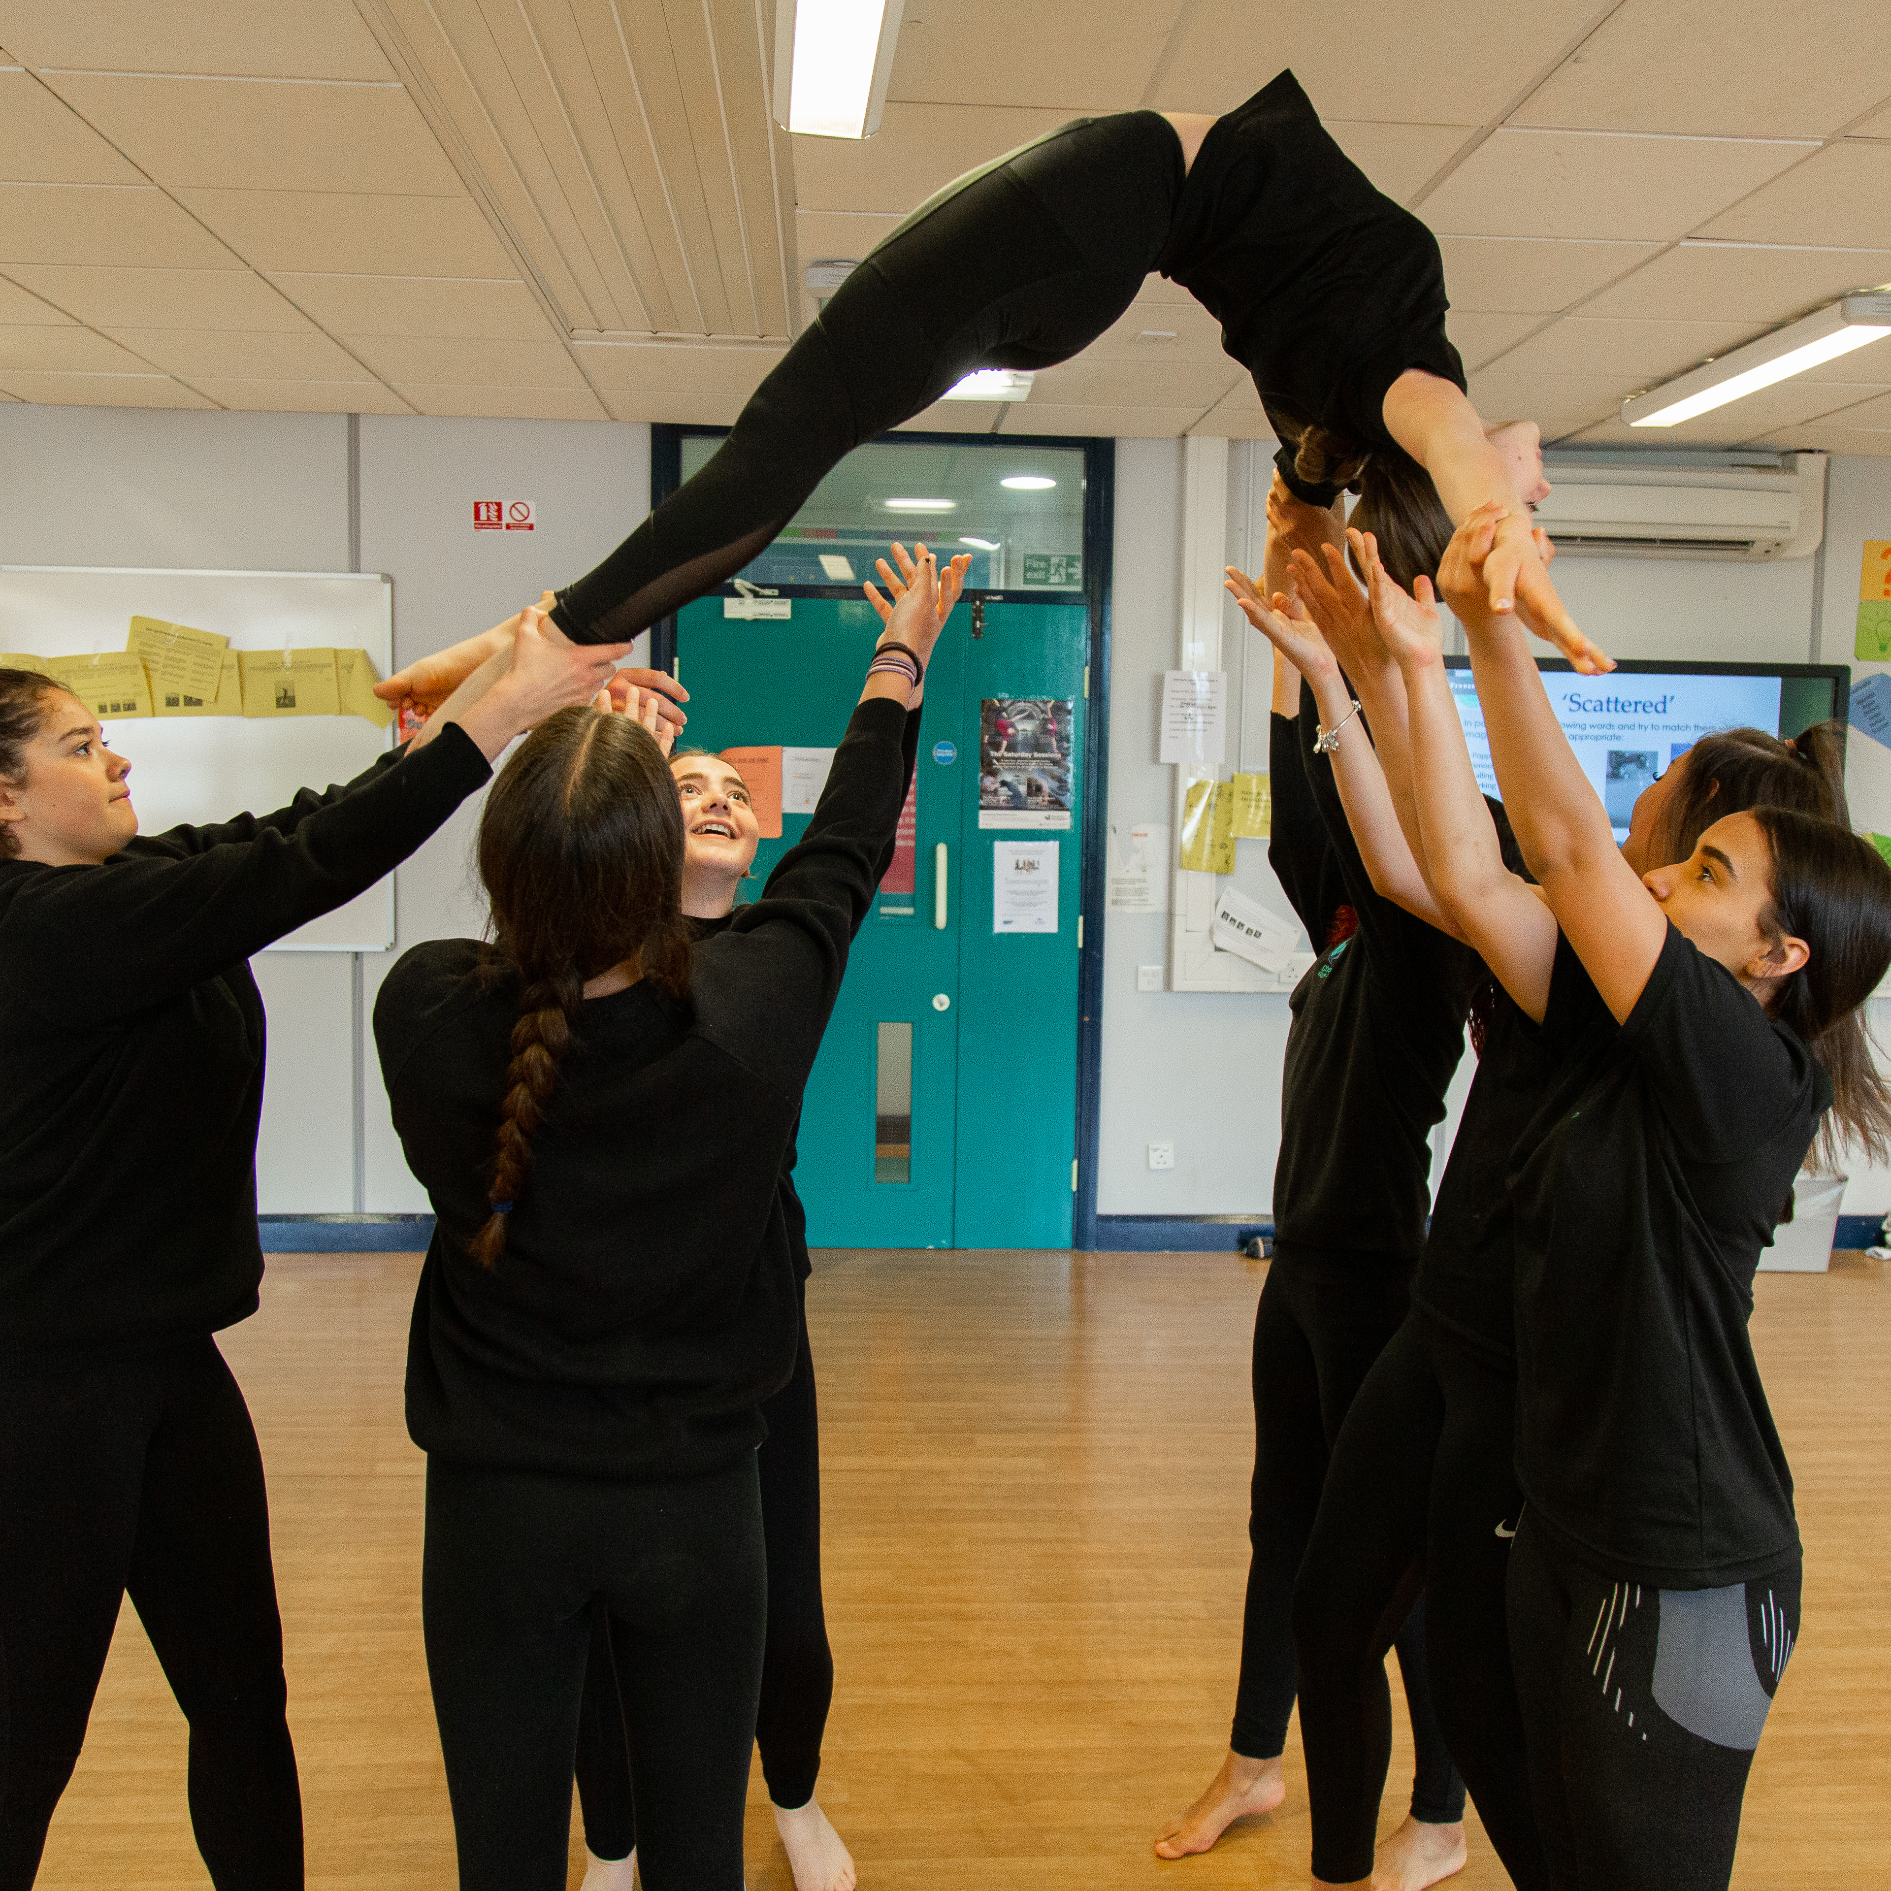
Why Artsmark?
Over 20 years’ experience transforming schools through arts and culture
World-leading teacher CPD delivered by Goldsmiths, University of London
Inspiring nearly two million pupils across 4,000 schools every year
A flexible framework that fits around
school planning cycles with only
two documents to submit.
Photo © Canteencreate / LIPA Primary and High School
Notes:
More on our 'WHY' here: Why Artsmark? | Artsmark

Slide 4
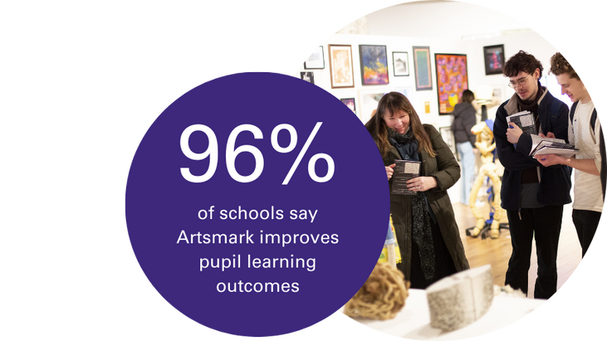

Transforming schools
Artsmark transforms whole schools and their local communities through creativity
Notes:
Visit Artsmark's website: Welcome (artsmark.org.uk)

Slide 5

Why is cultural education important?
The Cultural Learning Alliance's 2017 Imagine Nation report on the impact of cultural education showed:
participation in structured arts activities can increase cognitive abilities by 17%
learning through arts and culture can improve
attainment in Maths and English
students from low-income families who take
part in arts activities at school are three times
more likely to get a degree
The Centre for Social Justice’s 2023 Two Nations
report argues that improved access to extra-curricular
activities (including arts enrichment) could be part of the solution to
the current attendance crisis.
Photo © Mark Savage / Havelock Academy
Notes:
You can view the full Imagine Nation report here: ImagineNation: The value of Cultural Learning – Cultural Learning Alliance
You may also want to read The Cultural Learning Alliance’s 2024 Policy and Practice roundup 2024, which has more insightful reports on the impact of arts and cultural education: https://www.culturallearningalliance.org.uk/policy-and-practice-round-up-january-2024/

Slide 6

How Artsmark can help
Artsmark is proven to use creative and cultural education to:
support pupil outcomes, wellbeing and attendance
improve teacher recruitment, retention and confidence
significantly contribute to whole school improvement
Photo © Xavier Fiddes / Northway Primary School
Notes:
Read more case studies about the impact of Artsmark here: Artsmark in Action | Artsmark

Slide 7
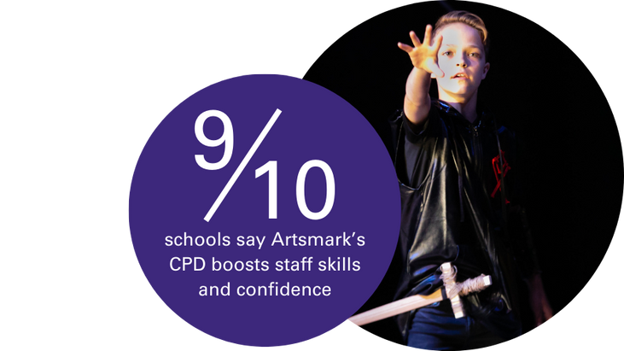
World-leading CPD
Artsmark training and support is delivered by Goldsmiths, University of London. Goldsmiths is a research and teaching university with a national and international reputation as a hub for creativity, arts and culture.
Your staff will feel empowered to become agents of change, building
their confidence in using action research whilst developing critical analysis and reflection skills.
“I thought the training was really empowering. I left excited to compile the information needed to complete our Statement of Impact to show what we have achieved as a school.”
Photo © Rob Freeman
Notes:
You can find out more about Goldsmiths training and support here: Goldsmiths training and support | Artsmark

Slide 8
Artsmark and Ofsted
Artsmark can significantly contribute to meeting Ofsted’s requirements for Quality of Education by using the Artsmark framework to maintain a broad and ambitious curriculum that connects learning across all subjects, as well as working towards Gatsby benchmark 5.
Artsmark equips pupils with the cultural capital they need to succeed in life and nurture their imagination and creativity through a high-quality arts and cultural education.
Artsmark has the potential to clearly demonstrate how you support personal development and provides evidence to Ofsted on how you meet its spiritual, moral, social and cultural requirements.
Artsmark considers the Ofsted framework in the resources it develops for schools, supporting leaders to understand how Artsmark can support the development of a broad and balanced curriculum.

Slide 9
What Artsmark schools report
96% say Artsmark’s improved their pupils’ learning outcomes
98% say Artsmark broadens and enriches their curriculum
96% say Artsmark’s supported school improvement plans
"We have seen an increase in whole school attendance over the course of our Artsmark journey. There has been a subsequent improvement in wellbeing and happiness which translates into higher levels of attendance."
Springfield Junior School, Artsmark Gold

Slide 10
A long-term investment
Artsmark costs just £500 for the entire two-year Artsmark journey, plus a further two years’ accreditation from the Arts Council. If you have fewer than 100 pupils, the cost is just £250.
This investment provides access to a wealth of CPD benefits including:
Artsmark development training for two members of staff delivered by Goldsmiths, plus ongoing support
a clear framework to plan, develop and embed arts, culture and creativity across the curriculum
Notes:
More on Artsmark's costs: Artsmark Investment | Artsmark

Slide 11
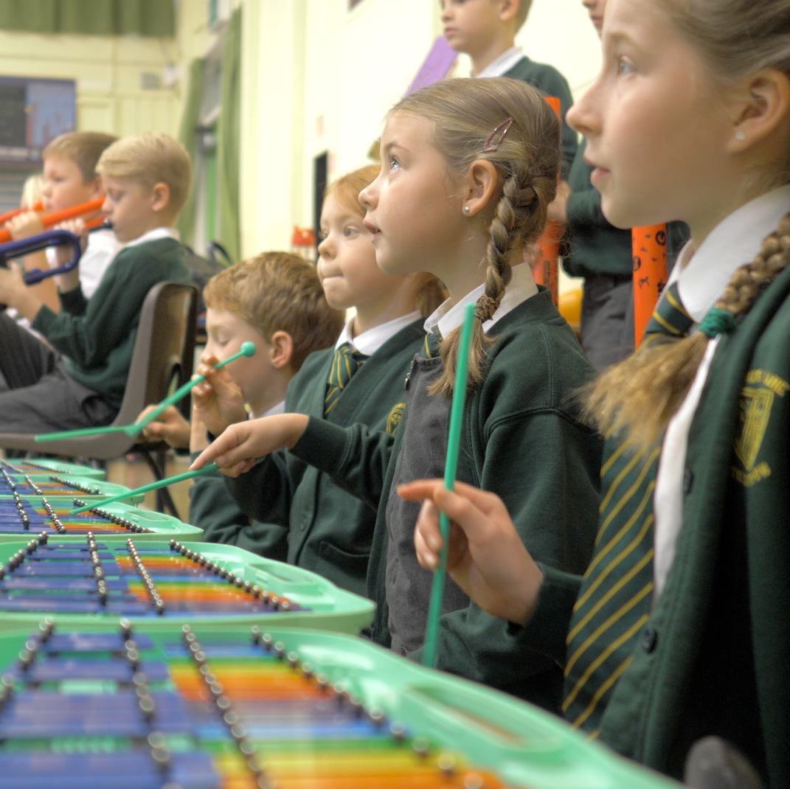
Our work with the NGA
The Arts Council has a strong partnership with the National Governance Association and has developed an e-learning module for governors and trustees about the value and impact of arts and cultural education, and how to embed across the organisation.
The module, available to NGA members, enables governors and trustees to develop their understanding of what arts and cultural education means and how it can be used for school improvement and enhancing the school curriculum.
Artsmark encourages governors and trustees to take the module and learn more about the value of cultural education.
Photo © Jack-All Productions / Strike Lane Primary School
Notes:
You can take the 'Arts, culture and creativity: improving your school or trust and its curriculum' module here: Arts, culture and creativity | National Governance Association (nga.org.uk)

Slide 12

Ready to get started?
It’s easy to get started. Complete a short online form and we’ll be in touch with your next steps.
artsmark.org.uk/register
"Our Artsmark journey has been a great success. Staff are really seeing the difference that learning through being creative can make to pupil understanding and wellbeing."
Highfield Littleport Academy,
Artsmark Silver
Photo © Callum Mcmorran / LIPA Primary and High School
Notes:
Register here: Register | Artsmark

Slide 13

Useful links
Artsmark web pages:
www.artsmark.org.uk
www.artsmark.org.uk/process
www.artsmark.org.uk/register
www.artsmark.org.uk/costs
www.artsmark.org.uk/training
NGA e-learning module:
https://www.nga.org.uk/training/directory/arts-culture-creativity-improving-school-trust-curriculum/
Cultural Learning Alliance reports:
https://www.culturallearningalliance.org.uk
Photo © Matthew Tiller

